Slide 1

Preventing High–Risk Falls in
The Emergency Department
Implementation of the MEDFRAT
Fall Risk Assessment Tool
David Malarkey, DNP(c), RN, PHN, CEN
California State University, Fresno
Doctor of Nursing Practice Program
Notes:
Final Doctoral Project Oral Defense

Slide 2
Acknowledgements
My Family, Alison, Ella, & Seth
Dr. Harkirat Bal – Project Chair
Dr. Nisha Nair – DNP Program Advisor
Carrie Carson – ED Assistant Director
Lisa Ortiz – Cohort / Peer / Friend
Support: Jay Ramos, Christy Peterson, Tracey Hanson, & Melissa Stroud

Slide 3
Problem Statement
A significant practice gap exists in the emergency department when fall-risk screening fails to detect transient states of impairment, such as intoxication, postictal state, sedation, and acute confusion, limiting timely identification and targeted prevention.
↑ LOS by ~6 to 12 Days
~$35,365 direct cost per Fall
47,026 Deaths in 2023 related to Falls

Slide 4
Project Purpose
Fall Definition
  An unplanned descent to the floor, ground, or a lower level
Implement MEDFRAT
  Memorial Emergency Department Fall Risk Assessment Tool
  ED-specific fall-risk screening tool
Compare MEDFRAT vs Current Screening
  Identification of transient high-risk states

Slide 5
Theoretical Framework
Lippitt’s Change Theory
Diagnosis / Gap:
  Transient ED fall risk not fully captured by Schmid
Readiness and Ability:
  Staff education and workflow preparation
Implementation:
  SmartPhrase deployment, go-live, and audit feedback
Transfer of Ownership:
  Onboarding, audit feedback, and operational sustainability

Slide 6
Review of Literature
Terrell et al. (2009):
  ED falls linked to dynamic cognitive states
Flarity et al. (2013) Gold Standard
  MEDFRAT was developed and validated for ED use
Brown (2017):
  Inpatient tools do not fit ED realities
McCarty et al. (2018) and Scott et al. (2018):
  MEDFRAT implementation feasible in ED workflow
Kitch & McCarty (2020):
  Adoption alone may not reduce falls; fidelity matters

Slide 7
Methods – Design & Setting
QI implementation with paired comparison
  (MEDFRAT vs Schmid)
Adult ED population (≥18 years),
  Northern California ED
Project Period:
  Baseline Jan 1 – Jun 30, 2025
  Go Live: Aug 15 – Dec 15, 2025
QI approved
  N = 1,189 paired encounters

Slide 8
Methods – Intervention & Measures
Retrospective Chart Review from Epic for baseline (historical) and live implementation period
Built and deployed an Epic SmartPhrase to standardize MEDFRAT documentation
Staff training/education sessions and workflow integration at go-live
Paired MEDFRAT vs Schmid screening captured for comparison
  Primary outcome: High-Risk identification
  Secondary outcome: Falls during study windows

Slide 9
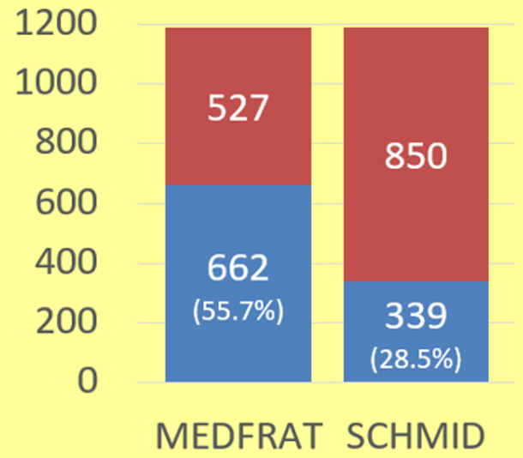
Primary Outcome
MEDFRAT Identified More At-Risk Encounters Than Schmid
  n = 1,189 paired encounters
    662 (55.7%) vs 339 (28.5%)
      Difference: +27.2 % points
    Discordant pairs:
      348 (29.3%) MEDFRAT-only vs 25 (2.1%) Schmid-only
Selling points to Staff
Notes:
Across 1,189 paired encounters, MEDFRAT identified significantly more at-risk patients than SCHMID, with discordant classifications strongly favoring MEDFRAT.
Discordant pairs reveal the mechanism: 348 MEDFRAT-only vs 25 Schmid-only – a 13.8:1 ratio heavily favoring MEDFRAT. This disproportionate disagreement is what drives the chi-squared result of 277.97."
Matched-pairs OR = 13.92 (95% CI 9.28, 20.89)

Slide 10
Primary Outcome
MEDFRAT Identified More At-Risk Encounters Than Schmid
  McNemar’s test:
    χ²(1) = 277.97,
      (Critical threshold 3.84) p < 0.001
    Discordant pairs
      Odds ratio 13.92
    Confidence Interval 9.28 to 20.89
Selling points to Academics
Notes:
Across 1,189 paired encounters, MEDFRAT identified significantly more at-risk patients than SCHMID, with discordant classifications strongly favoring MEDFRAT
Matched-pairs OR = 13.92 (95% CI 9.28, 20.89)

Slide 11
Baseline Falls (Jan 1 – June 30) 38 falls per 59,070 visits = 0.64 falls per 1000
Go-Live (Aug 15 – Dec 15) 15 falls per 38,171 visits = 0.39 Falls per 1000
39.1% decrease in falls per 1,000 visits from baseline to go-live.
Absolute change is -0.25 falls per 1,000.
*** Falls were rare events. These data are descriptive and not the primary effectiveness test.
Notes:
Falls were rare events. These data are descriptive and not the primary effectiveness test.
The Hawthorne Effect is when people change their behavior because they know they're being observed or studied – not because of the intervention itself, but because they feel watched.

Slide 12
Baseline Falls (Jan 1 – June 30) 51 falls per 59,070 visits = 0.86 falls per 1000
Go-Live (Aug 15 – Dec 15) 26 falls per 38,171 visits = 0.68 Falls per 1000
20.9% decrease in falls per 1,000 visits from baseline to go-live.
Absolute change is -0.18 falls per 1,000.
Notes:
The Hawthorne Effect is when people change their behavior because they know they're being observed or studied – not because of the intervention itself, but because they feel watched.

Slide 13
Discussion / Outcomes
MEDFRAT identified more at-risk encounters than Schmid
  55.7% vs 28.5% (+27.2 percentage points)
  chi-squared = 277.97 (Difference confirmed beyond chance)
  Odds Ratio = 13.92, 95% (Fourteen times more likely to be detected)
  Confidence Interval = 9.28-20.89 (Precise and reproducible finding)
Most Disagreement was MEDFRAT-only Risk Identification
  29.3% MEDFRAT-only vs 2.1% Schmid-only
Findings support that ED Fall Risk is often Transient
  under-detected by inpatient-derived screening

Slide 14
Limitations
Single-site QI project
  Local workflow influences results
Pre/post windows differ seasonally
  Go-live mid-month
  Hawthorne Effect
Falls are rare events
  Multi-factoral
  This project more directly supports improved risk identification than causal reduction in falls.
  Rate changes require longer observation

Slide 15
Implications / Sustainability / Recommendations
Maintain Training and education for new staff
Continue audit monitoring with feedback to sustain fidelity
Embed MEDFRAT fields into standard flowsheets/triage documentation to improve speed, adoption, & reviewability
Recommendation:
  Extend surveillance over a longer post-implementation period to evaluate whether improved identification translates into sustained fall reduction.

Slide 16
Conclusions
The takeaway is that MEDFRAT identified substantially more ED patients at risk for falls than the Schmid tool, especially during transient high-risk states, supporting the use of an ED-specific screening approach to improve early recognition and targeted prevention

Slide 17
References
Bouldin, E. L. D., Andresen, E. M., Dunton, N. E., Simon, M., Waters, T. M., Liu, M., Daniels, M. J., Mion, L. C., & Shorr, R. I. (2013). Falls among adult patients hospitalized in the United States: Prevalence and trends. Journal of Patient Safety, 9(1), 13-17. https://doi.org/10.1097/PTS.0b013e3182699b64
Brown, C. A. (2017). Evaluation of current emergency department fall risk assessment tools: Is an emergency department specific fall risk assessment tool needed? [Master’s thesis, St. John Fisher University].
Centers for Disease Control and Prevention. (n.d.). Accidents or unintentional injuries. National Center for Health Statistics, FastStats. https://www.cdc.gov/nchs/fastats/accidental-injury.htm
Dykes, P. C., Curtin-Bowen, M., Lipsitz, S. R., Yuan, C., Benoit, A., Chang, F., Czyzewski, K., Fitzpatrick, J. J., Mahoney, M., Pan, B., Shill, H., Bates, D. W., & Adelman, J. S. (2023). Cost of inpatient falls and cost-benefit analysis of implementation of an evidence-based fall prevention program. JAMA Health Forum, 4(1), e225125. https://doi.org/10.1001/jamahealthforum.2022.5125
Flarity, K., Pate, T., & Finch, H. (2013). Development and implementation of the Memorial Emergency Department Fall Risk Assessment Tool. Advanced Emergency Nursing Journal, 35(1), 57-66.
Lippitt, R., Watson, J., & Westley, B. (1958). The dynamics of planned change: A comparative study of principles and techniques. Harcourt, Brace.
McCarty, C. A., Harry, M. L., Woehrle, T. A., & Kitch, L. A. (2020). Screening and falls in community hospital emergency rooms in the 12 months following implementation of MEDFRAT. The American Journal of Emergency Medicine, 38(8), 1686-1687.
McCarty, C. A., Woehrle, T. A., Waring, S. C., Taran, A. M., & Kitch, L. A. (2018). Implementation of the MEDFRAT to promote quality care and decrease falls in community hospital emergency rooms. Journal of Emergency Nursing, 44(3), 280-284.
McNemar, Q. (1947). Note on the sampling error of the difference between correlated proportions or percentages. Psychometrika, 12(2), 153-157.
Scott, R. A., Oman, K. S., Flarity, K., & Comer, J. L. (2018). Above, beyond, and over the side rails: Evaluating the new Memorial Emergency Department fall-risk-assessment tool. Journal of Emergency Nursing, 44(5), 483-490.
Terrell, K. M., Weaver, C. S., Giles, B. K., & Ross, M. J. (2009). ED patient falls and resulting injuries. Journal of Emergency Nursing, 35(2), 89-92.

Slide 18

Thank You
This QI project supports patient safety by improving the identification of emergency department patients at risk for falls
Questions & Discussion

