Slide 1
Closing the Gap in Pediatric Asthma Care:
A Nurse-Led Quality Improvement Initiative to Standardize
Pediatric Asthma Score Use in the Emergency Department
Lisa D. Ortiz, MSN, RN, DNPc
California State University, Fresno
Doctor of Nursing Practice Program
Spring 2026
Notes:
Good morning, and thank you for being here.
My name is Lisa Ortiz, and today I’ll be presenting my Doctor of Nursing Practice project titled Closing the Gap in Pediatric Asthma Care: A Nurse-Led Quality Improvement Initiative to Standardize Pediatric Asthma Score Use in the Emergency Department.

Slide 2
Acknowledgements
Dr. Lynn Jakobs, PhD — Project Chair
Doctor of Nursing Practice Committee Members
Emergency Department Leadership and Educators
Emergency Department Nursing Colleagues
David Malarkey — cohort member and friend for his encouragement and support
Family and Support System
Notes:
I’d like to begin by acknowledging my project chair, Dr. Lynn Jakobs, my committee members, and the emergency department leadership and staff who supported this work. I’d also like to recognize David Malarkey, a cohort member and friend, for his encouragement and support throughout this journey. Lastly I am grateful to my family for their continued support throughout this process.

Slide 3
Introduction
Asthma is a leading cause of pediatric emergency department visits
Timely intervention is critical to prevent respiratory decompensation
Care delivery depends on accurate severity recognition at triage
Project conducted in a Northern California integrated HMO emergency department
Notes:
Asthma remains one of the most common reasons children present to the emergency department.
Timely intervention is critical to prevent worsening respiratory distress.
However, care delivery depends heavily on accurate severity recognition at triage.
This project was conducted in a high-volume emergency department within a Northern California integrated health system.

Slide 4
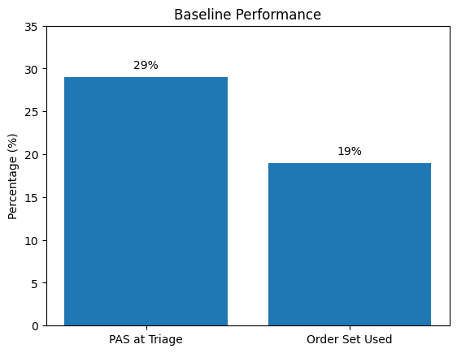
Problem Statement and Gap Analysis
Pediatric Asthma Score (PAS) documented at triage in 29% of encounters
  Based on 115 pediatric asthma visits (Dec 2024–Mar 2025)
  Median time to first bronchodilator exceeded 100 minutes when PAS was absent
  Asthma order set utilized in 19% of visits overall
Significant gap in standardized assessment and treatment
Notes:
Baseline data revealed that PAS was documented at triage in only 29% of encounters.
Additionally, when PAS was not documented, median time to bronchodilator exceeded 100 minutes.
Asthma order set utilization was also low, at just 19%.
These findings highlighted a gap in standardized severity assessment and timely care delivery.

Slide 5
Purpose of the Project
Standardize Pediatric Asthma Score (PAS) documentation at triage for pediatric patients presenting with asthma exacerbations
Improve early recognition of asthma severity to support timely clinical decision-making
Reduce time from arrival to bronchodilator administration
Promote consistent, nurse-driven, evidence-based care in the emergency department
Notes:
The purpose of this project was to standardize PAS documentation at triage, improve early recognition of asthma severity, support timely clinical decision-making, and promote consistent, nurse-driven, evidence-based care in the emergency department.

Slide 6
Theoretical Framework
Knowles’ Adult Learning Theory
  Guided staff education strategies
  Focused on relevance to ED workflow
Watson’s Theory of Human Caring
  Supports holistic, patient-centered assessment
  Reinforces early recognition of patient needs
Notes:
This project was guided by Knowles’ Adult Learning Theory, which informed the design of the educational intervention by focusing on practical, real-time application for nursing staff.
Jean Watson’s Theory of Human Caring also supported this work by emphasizing the importance of holistic, patient-centered assessment.
In the context of this project, early and accurate severity recognition through PAS aligns with caring practices that prioritize timely, appropriate intervention for pediatric patients.

Slide 7
Review of the Literature
Standardized asthma severity scoring improves clinical decision-making (GINA, 2023; NAEPP, 2020)
Early bronchodilator administration improves outcomes (Ciarallo et al., 2006)
Inconsistent tool adoption linked to workflow barriers (Sullivan et al., 2014)
Nurse-driven protocols reduce variation (Babl et al., 2018)
Notes:
The literature supports the use of standardized asthma scoring to improve clinical decision-making.
Early bronchodilator administration is associated with improved outcomes.
However, adoption of these tools is often inconsistent due to workflow barriers.
Studies also support nurse-driven protocols as a way to reduce variation in care.

Slide 8
Participants
Participants
Pediatric patients (ages 0–18) with asthma-related ED visits
High-volume emergency department in Northern California
Sample
377 encounters meeting inclusion criteria
Selection Criteria
Included: Asthma-related visit + received bronchodilator
Excluded: Missing timing data, no bronchodilator, incomplete records
Data Source
Retrospective chart review of EHR data
Notes:
This project included pediatric patients aged 0 to 18 presenting with asthma-related complaints in a high-volume emergency department.
A total of 377 encounters met inclusion criteria.
Patients were included if they had an asthma-related visit and received bronchodilator therapy.
Cases were excluded if medication timing data was missing, no bronchodilator was administered, or records were incomplete.
Data was collected through retrospective chart review of the electronic health record.

Slide 9
Methods (PDSA Framework)
Plan
Do
Study
Reinforced practice
Identified PAS gap
Education and tools
Evaluated PAS and timing
Act
Notes:
This project followed the Plan–Do–Study–Act framework.
The intervention included multimodal nursing education, such as PAS training, badge cards, and visual reminders.
Data was collected from the EHR, including timestamps for arrival, PAS documentation, and medication administration.
IRB approval was obtained prior to implementation.

Slide 10
Project Implementation
Nursing education focused on PAS use at triage
  Targeted nursing education
  Badge cards + visual reminders
  Workflow integration
Notes:
The intervention focused on reinforcing PAS use at triage through education, visual reminders, and integration into existing workflows.
Ongoing reinforcement was provided through communication and feedback to staff.

Slide 11
Measures and Analysis
Primary outcome: PAS documentation
Secondary outcomes:
  door-to-albuterol
  Order set usage
Notes:
Data was analyzed using a pre- and post-intervention design.
Outcomes included PAS documentation rates, door-to-albuterol time, and order set utilization.
The intervention period occurred in August 2025, with post-implementation data collected from September through December.

Slide 12
Project Timeline
Baseline
Jan–Aug 2025
Education
Aug 2025
Evaluation
Sept–Dec 2025
Dissemination
Jan–Mar 2026
Notes:
The project followed a structured timeline beginning with baseline data collection, followed by a focused education intervention in August, and a post-implementation evaluation period through December. Final analysis and dissemination occurred in early 2026

Slide 13
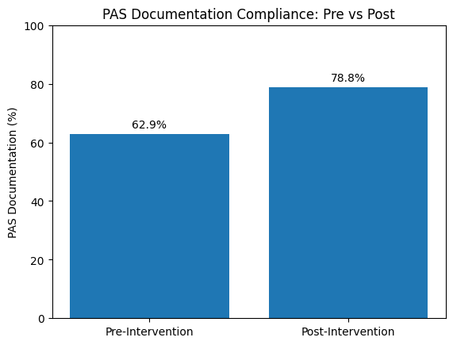
Results: PAS Documentation Compliance
Pre: 62.9%
Post: 78.8%
+15.9% improvement
OR = 2.19 (CI [1.29–3.72])
Notes:
PAS documentation improved from 62.9% to 78.8%, representing a 15.9 percentage point increase. This improvement was statistically significant, with an odds ratio of 2.19 and a confidence interval that does not cross 1.
These findings demonstrate that improving upstream nursing processes is achievable; however, impacting downstream clinical outcomes requires interdisciplinary and system-level change.

Slide 14
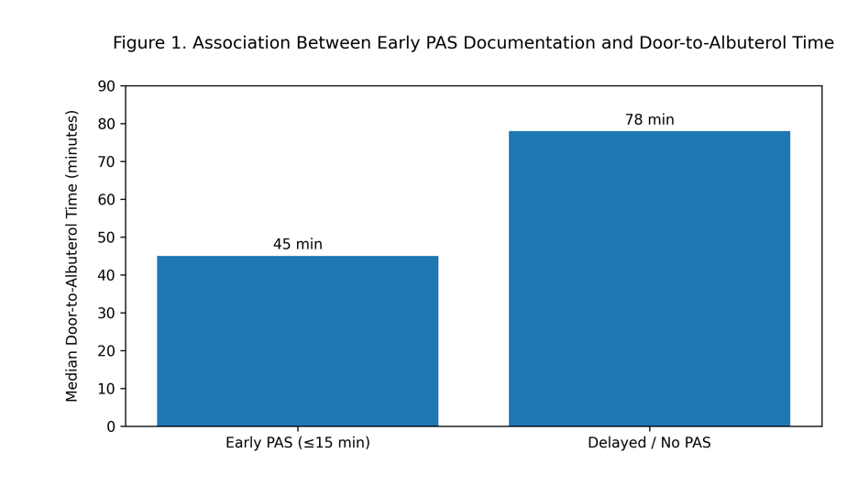
Results: Association between early PAS documentation and Door-to-albuterol time
Association between early Pediatric Asthma Score documentation (≤15 minutes from arrival) and median door-to-albuterol time
Notes:
This figure visually demonstrates the association between early PAS documentation, defined as within 15 minutes of arrival, and shorter median door-to-albuterol times compared to delayed or absent PAS documentation.

Slide 15
Discussion
PAS documentation improved significantly following the educational intervention
No significant improvement in door-to-albuterol time or order set utilization
Findings suggest nursing-focused interventions improve documentation but do not independently change provider-driven or system-level outcomes
Results are consistent with literature identifying workflow and interdisciplinary barriers
Notes:
The results show that the intervention was effective in improving PAS documentation, which was the primary aim of the project. However, this improvement did not translate into changes in treatment timing or order set use. This suggests that while nursing behavior can be modified through education, downstream clinical outcomes are influenced by additional factors such as provider decision-making and workflow processes. These findings are consistent with existing literature that highlights interdisciplinary barriers in implementing standardized care.

Slide 16
Implications for Nursing Practice
Standardized PAS use at triage supports early severity recognition
Nurse-driven interventions can improve consistency in care delivery
Targeted education and visual tools are effective, low-cost strategies
Interdisciplinary collaboration is needed to impact clinical outcomes
Notes:
This project highlights the important role nurses play in early severity recognition and standardization of care. Implementing PAS at triage supports more consistent, evidence-based decision-making. It also demonstrates that simple, low-cost strategies such as targeted education and visual reminders can improve practice. However, improving clinical outcomes such as treatment timing requires collaboration across disciplines, particularly with providers and system-level workflow integration.

Slide 17
Limitations, Sustainability, and Conclusions
Limitations
Sustainability
Conclusions
Single-site project
Ongoing staff education and reinforcement
Standardizing PAS use at triage is feasible and clinically meaningful
Nursing-focused intervention
ED workflow variability
Integration into ED workflow and culture
Improving upstream nursing processes is achievable; however, impacting downstream clinical outcomes requires interdisciplinary and system-level change.
Notes:
This project has several limitations, including its single-site design and reliance on retrospective data.
Sustainability will require continued reinforcement, integration into workflow, and expansion to interdisciplinary teams.
In conclusion, this project improved PAS documentation but highlighted that improving clinical outcomes requires broader, system-level interventions.

